Slide 1
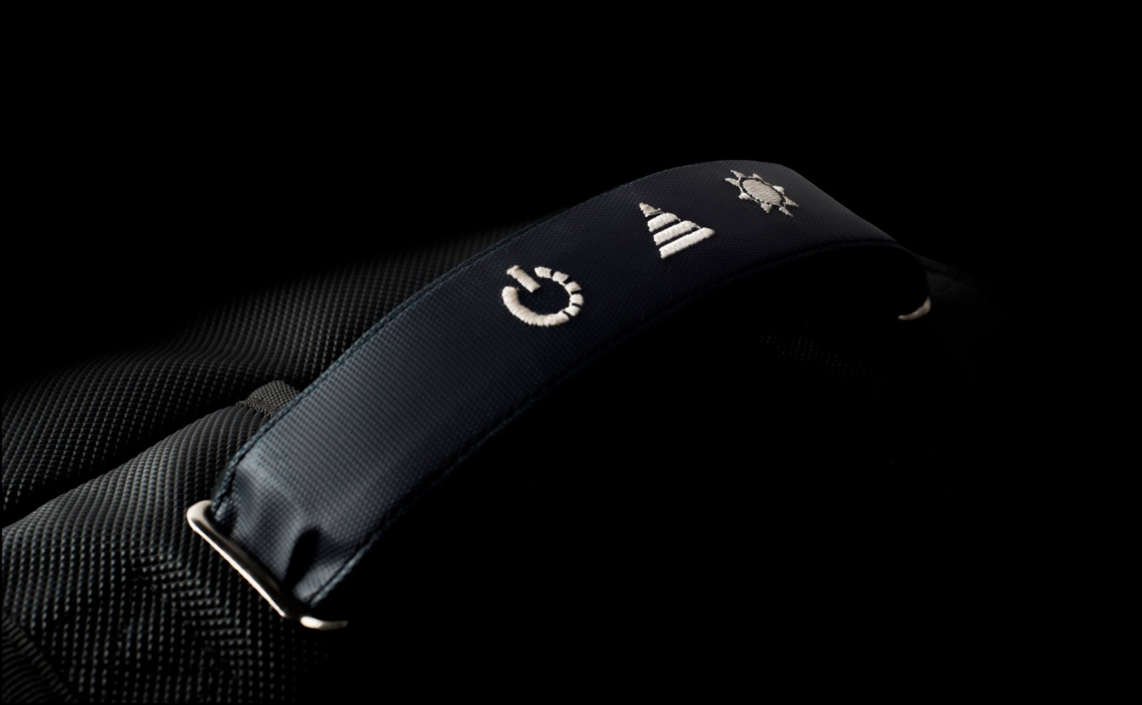
Press Me Once to turn the Secure mode ON
Press Me once to illuminate the Inner LED.
Press me again to switch OFF the LED
Press Me for 1.5 seconds to Disable Secure mode
Press Me for 1.5 seconds and I will allow You to charge Your Power Bank without getting it Out of Me with Our Special Converter
Press Here for 3 Seconds to Let Me Sleep.
Press Me for 1.5 seconds enable Silent Mode
Press Me Once to Toggle Between Pre-defined Animations

Slide 2
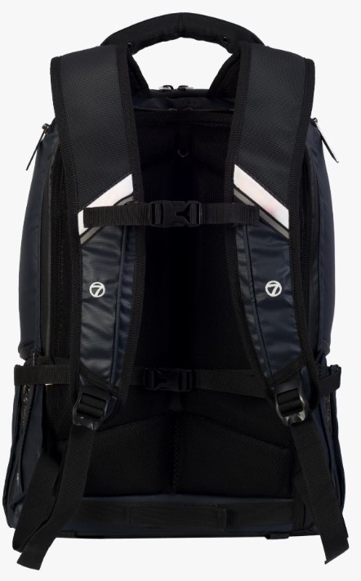
RIGHT STRAP BUTTON
LEFT STRAP BUTTON
LEFT STRAP BUTTON
Press once to ON/ OFF the Inner LED
Press Me Once to turn the Secure mode ON
Press Me for 3 Seconds to turn On/OFF the Ride Mode
Press Me for 1.5 seconds to turn On/OFF the Silent Mode
If you are in the Ride Mode Press Me Once to turn On/OFF the Right Indicator
If you are in the Ride Mode Press Me Once to turn ON/OFF the Left Indicator

